Slide 1



Ad-Hoc Insights
Consumer Goods
Presented By : Ankita Gupta

Slide 2
Introduction
AtliQ Hardwares (imaginary company) is one of the leading computer hardware producers in India and has expanded well in other countries too.
Problem Statement
The management felt they weren’t getting enough insights to make quick, data-driven decisions. So, Tony Sharma decided to hire junior data analysts and created a SQL challenge to test both technical and soft skills.

Slide 3
List of Market in APAC Region
Question. 1
Provide the list of markets in which customer "Atliq Exclusive" operates its business in the APAC region.
Input
Select distinct market
from dim_customer
where customer = 'Atliq Exclusive’
and
region = 'APAC’
;

Slide 4

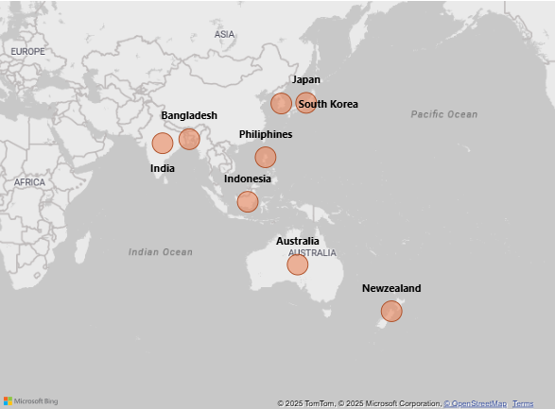
Conversion of Output To Visual
Output
Insights
The customer “Atliq Exclusive” operates its business across several key markets within the APAC (Asia–Pacific) region. According to the data, their presence spans eight countries, indicating a strong regional footprint.

Slide 5
Percentage of Unique Products
Question .2
What is the percentage of unique product increase in 2021 vs. 2020? The final output contains these fields, unique_products_2020 unique_products_2021 percentage_chg
Query
with cte1 as (
select count(distinct product_code) as unique_product_2020
from fact_sales_monthly
where fiscal_year = 2020
),
cte2 as (
select count(distinct product_code) as unique_product_2021
from fact_sales_monthly
where fiscal_year = 2021
)
select
unique_product_2020,
unique_product_2021,
(unique_product_2021-unique_product_2020)*100/unique_product_2020 as pct_change
from cte1
cross join cte2
;

Slide 6
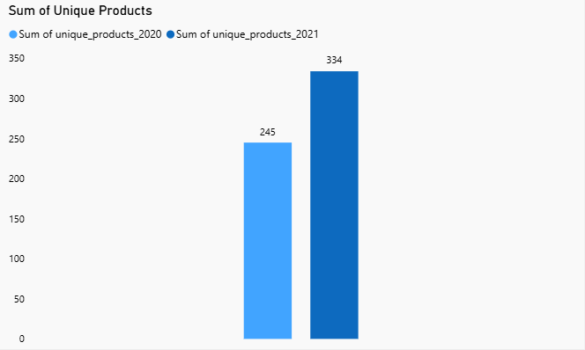

Conversion of Output To Visual
Output
36.32 %
Insights
There was 36.32% growth in the number of unique products from 2020 to 2021.

Slide 7
Unique Product Counts for each Segment
Question. 3
Provide a report with all the unique product counts for each segment and sort them in descending order of product counts. The final output contains 2 fields, segment product_count
Query
select
segment,
count(distinct product_code) as product_count
from dim_product
group by segment order by product_count desc
;

Slide 8
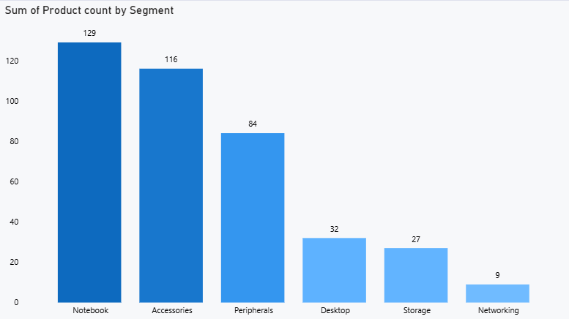
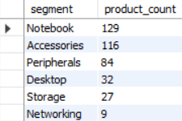
Conversion of Output To Visual
Output
Alarming
Insights
The Notebook and Accessories segments have the highest variety of products, showing strong product presence in these categories.
The AtliQ Hardware can explore market trends and customer needs to introduce new products in the Networking and Storage segments.

Slide 9
Increase in Unique Products
Question. 4
Follow-up: Which segment had the most increase in unique products in 2021 vs 2020? The final output contains these fields, segment product_count_2020 product_count_2021 difference
Query
with unique_product as(
select
p.segment,
count(distinct(case when fiscal_year = 2020 then s.product_code end)) as product_count_2020,
count(distinct(case when fiscal_year = 2021 then s.Product_code end)) as product_count_2021
from fact_sales_monthly s
join dim_product p
on p.product_code= s.product_code
group by p.segment )
select *, (product_count_2021 - product_count_2020) AS difference
from unique_product
Order by difference desc
;

Slide 10
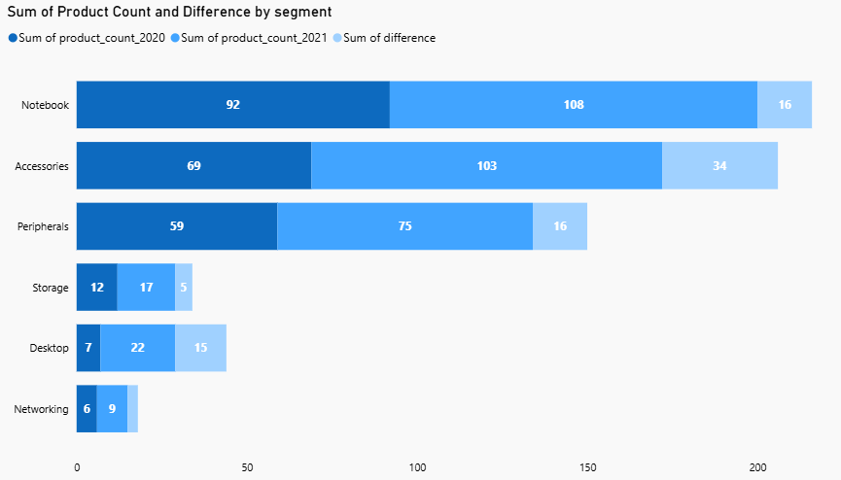
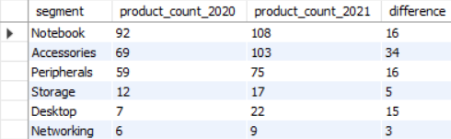
Conversion of Output To Visual
Output
Insights
The Accessories segment saw the highest increase of 34 unique products (69 → 103), while Notebook grew by 16 (92 → 108), showing the company’s focus on expanding product variety to meet customer demand.

Slide 11
List of Manufacturing Costs
Question. 5
Get the products that have the highest and lowest manufacturing costs. The final output should contain these fields, product_code, product, manufacturing_cost
Query
(select
p.product_code,
p.product,
m.manufacturing_cost
from dim_product p
join fact_manufacturing_cost m
on p.product_code= m.product_code
order by manufacturing_cost desc
limit 1)
Union
(select
p.product_code, p.product, m.manufacturing_cost
from dim_product p
join fact_manufacturing_cost m
on p.product_code= m.product_code
order by manufacturing_cost asc
limit 1)
;

Slide 12



Conversion of Output To Visual
Output
$240.54
$0.89
Personal Desktop
Mouse
AQ HOME Allin 1 Gen 2
AQ Master wired 1 Gen 2
Insights
  Desktop has the highest manufacturing cost at $240.54, reflecting its complex build.
  Mouse has the lowest cost at $0.89, making it the most economical to produce.

Slide 13
Top 5 Customers with % Discount
Question. 6
Generate a report which contains the top 5 customers who received an average high pre_invoice_discount_pct for the fiscal year 2021 and in the Indian market. The final output contains these fields, customer_code customer average_discount_percentage
Query
with cte1 as(
select *
from fact_pre_invoice_deductions
join dim_customer c
using(customer_code)
where fiscal_year=2021 and c.market='India’
)
select
customer_code,
customer,
concat(round(avg(pre_invoice_discount_pct)*100,2),"%") as avg_discount_pct
from cte1
group by customer_code, customer
order by avg(pre_invoice_discount_pct)*100 desc
limit 5
;

Slide 14
Fiscal Year of Atliq Hardwares
For this project, FY 2021 follows the company’s fiscal calendar, starting in September 2020 and ending in August 2021
FY 2021 Quarters
Q1: September 2020 – November 2020
Q2: December 2020 – February 2021
Q3: March 2021 – May 2021
Q4: June 2021 – August 2021

Slide 15
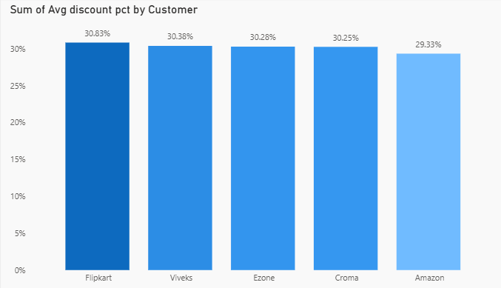
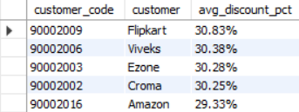
Conversion of Output To Visual
Output
Insights
All top 5 customers received ~31% average discount, showing AtliQ followed a consistent discounting approach for its major Indian clients in Fiscal Year 2021.

Slide 16
Monthly Gross Sales of Atliq Exclusive
Question. 7
Get the complete report of the Gross sales amount for the customer “Atliq Exclusive” for each month . This analysis helps to get an idea of low and high-performing months and take strategic decisions. The final report contains these columns: Month Year Gross sales Amount
Output
Select
monthname(s.date) as month,
s.fiscal_year as year,
sum(sold_quantity*gross_price) as gross_sales
from fact_sales_monthly s
join fact_gross_price g
on s.product_code= g.product_code
join dim_customer c
on s.customer_code = c.customer_code
where customer = "AtliQ Exclusive“
group by month,year
order by year asc
;

Slide 17
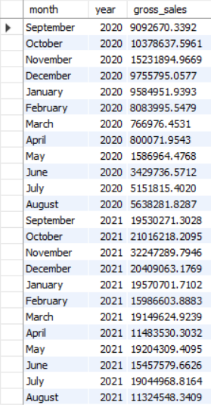
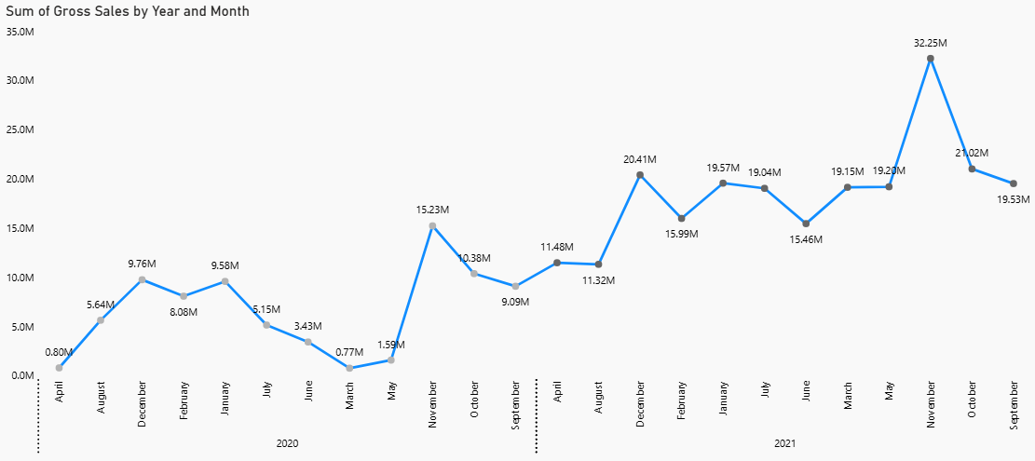
Conversion of Output to visual
Output
FY 2020
FY 2021
Lowest Gross Sales 0.77 M
Highest Gross Sales
32.25 M
Insights
Gross sales for Atliq Exclusive were significantly higher in both 2020 and 2021 during the month of November, while the lowest sales were recorded in March for 2020 and in August for 2021. This shows a strong year-end demand surge that the business can use for better planning and targeted strategies.

Slide 18
Total Sold Quantity of Quarter 2020
Question. 8
In which quarter of 2020, got the maximum total_sold_quantity? The final output contains these fields sorted by the total_sold_quantity, Quarter total_sold_quantity
Output
select
(
case
when month(date) in (9, 10, 11) then "Q1“
when month(date) in ( 12,1, 2) then "Q2“
when month(date) in ( 3, 4, 5) then "Q3“
when month (date) in (6,7,8) then "Q4“
end) as Quarter,
sum(sold_quantity) as total_sold_qty
from fact_sales_monthly
where fiscal_year = 2020
group by Quarter
order by total_sold_qty desc
;

Slide 19
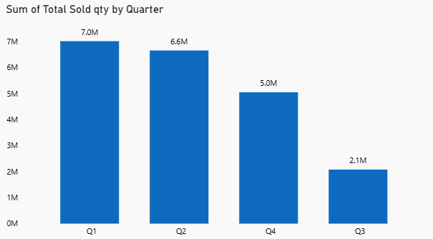
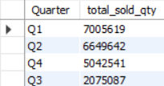
Conversion of Output To Visual
Output
Insights
Q1 recorded the highest total sold quantity at 7M units, reflecting strong demand in the early fiscal period. In contrast, Q3 posted the lowest volume at 2.1M units, indicating a considerable slowdown in market activity.
The drop in Q3 suggests a need to understand customer needs better during that time.

Slide 20
Gross Sales of Channel in FY 2021 & % contribution
Question. 9
Which channel helped to bring more gross sales in the fiscal year 2021 and the percentage of contribution? The final output contains these fields, channel gross_sales_mln percentage
Query
with cte1 as (
select
c.channel,
round(sum(sold_quantity*gross_price)/1000000) as gross_sales_mln
from dim_customer c
join fact_sales_monthly s
on s.customer_code = c.customer_code
join fact_gross_price g
on g.product_code = s.product_code
where s.fiscal_year = 2021
group by c.channel
)
select *,
concat(round(gross_sales_mln*100/ (select sum(gross_sales_mln) from cte1),2)," %") as pct_contribution
from cte1
order by pct_contribution desc
;

Slide 21
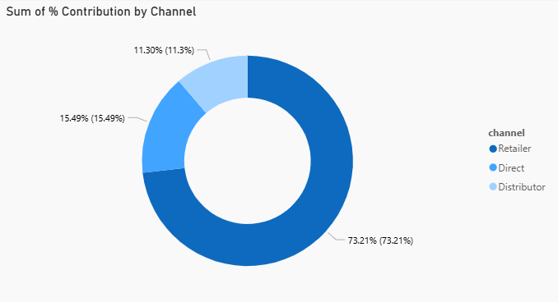

Conversion of Output To Visual
Insights
Retailer was the strongest performing channel in FY 2021, generating $1,924M and contributing 73.21% of the total gross sales.
Direct and Distributor channels contributed 15.49% and 11.30% respectively, indicating a significantly smaller share compared to Retailer.

Slide 22
Top 3 Products in each Division
Question. 10
Get the Top 3 products in each division that have a high total_sold_quantity in the fiscal_year 2021? The final output contains these fields,
1.division 2.product_code 3.product 4.total_sold_quantity 5. rank_order
Query
with cte1 as (
select
p.division,
s.product_code,
concat(p.product, ' (', p.variant, ')') AS product,
sum(s.sold_quantity) AS total_sold_qty,
rank() over (partition BY p.division ORDER BY SUM(s.sold_quantity) DESC) AS rank_order
from dim_product p
join fact_sales_monthly s
on p.product_code = s.product_code
where fiscal_year = 2021
group by p.division, s.product_code, p.product, p.variant
)
select *
from cte1
where rank_order in (1, 2, 3)
order by division, rank_order asc
;

Slide 23
Division:
1.N&S: Network and Storage
e.g: Wi-Fi routers/extenders, External Hard Drives
2.P&A: Peripherals and Accessories
e.g: Mouse and Keyboard, Monitors
3.PC: Personal Computer
e.g: Desktops, Laptops

Slide 24
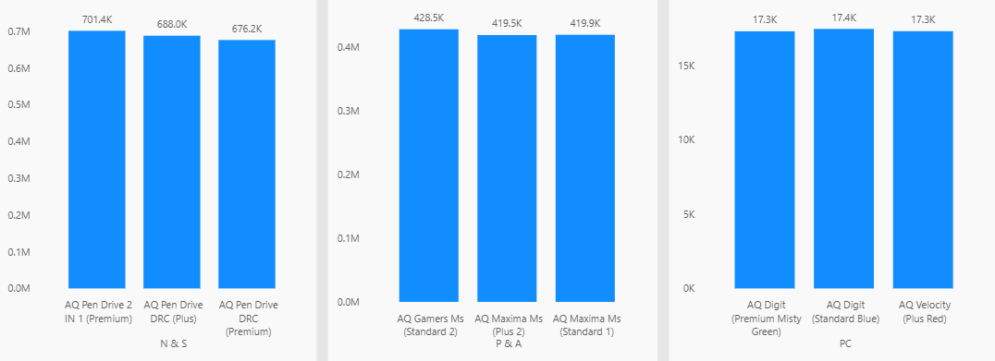
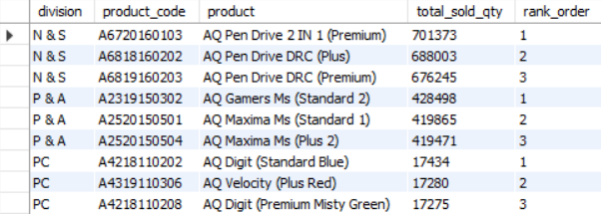
Conversion of Output To Visual
Output
Insights
In the N&S Division the top-selling product was AQ Pen Drive 2 IN 1 (Premium) achieving 701.4k units, indicating strong customer demand.
Other top products, AQ Gamers Ms (Standard 2) from P&A and AQ Digit (Standard Blue) from PC maintained competitive sales, showing a well-balanced product performance.

Slide 25
THANK YOU

